Slide 1
DIGILOCKER
Name | Roll No | USN
Supriya P | 229 | 01fe19bcs103
Sindhu S J | 253 | 01fe19bcs129
Chetan B | 255 | 01fe19bcs132

Slide 2

Introduction
DigiLocker is an Indian digitization online service provided by Ministry of Electronics and Information Technology (MeitY), Government of India under its Digital India initiative.
DigiLocker provides an account in cloud to every Aadhaar holder to access authentic documents/certificates such as driving license, vehicle registration, academic mark sheet in digital format from the original issuers of these certificates.

Slide 3
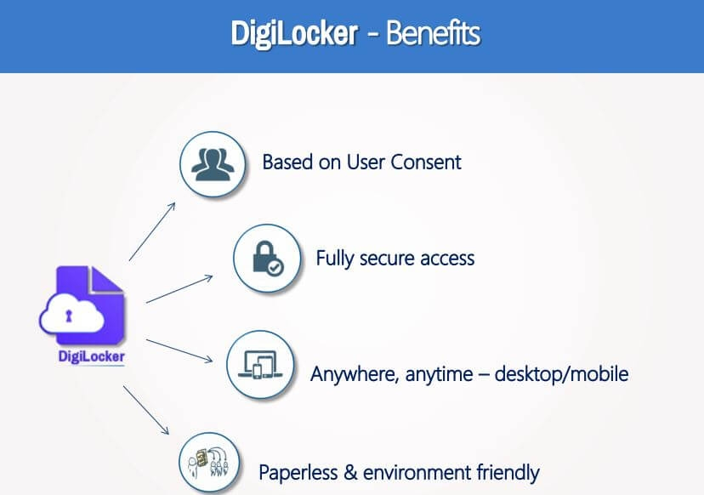
Why Digilocker??

Slide 4
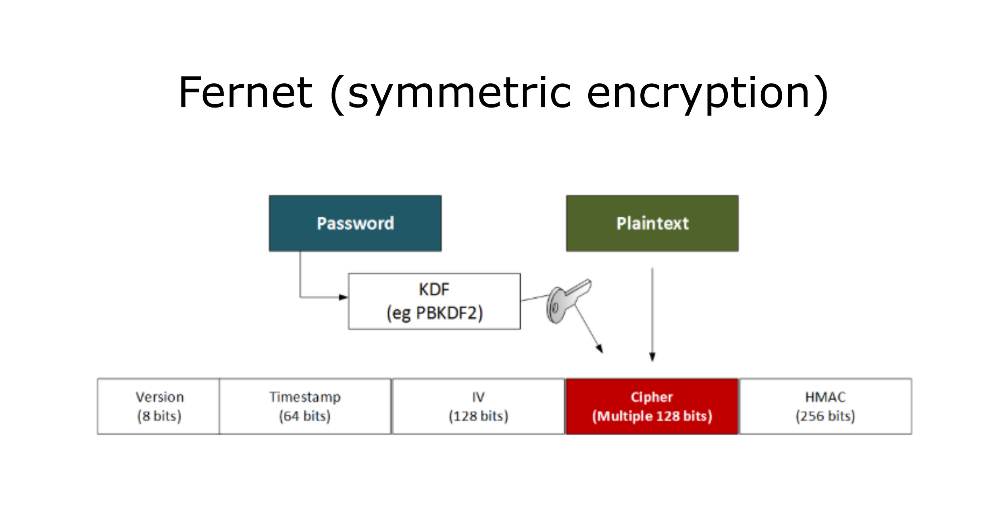
How it was Secured??
Providing a secure mechanism for generating keys (a key is similar to a password).
Selection a secure encryption algorithm (AES using CBC mode and PKCS7 padding)
Randomly allocating a secure "salt" value IV) to make the encryption more secure.
Timestamping the encrypted message.
Signing the message (using HMAC and SHA256) to detect any attempts to change it.

Slide 5
THANK YOU

